Slide 1
Poptrie A Compressed Trie with Population Count for Fast and Scalable Software IP Routing Table Lookup
Author: Hirochika Asai, Yasuhiro Ohara
Publisher: 2015 SIGCOMM
Presenter: Yi-Hao Lai
Date: 2016/03/22
Department of Computer Science and Information Engineering
National Cheng Kung University, Taiwan R.O.C.
Notes:
1

Slide 2
Introduction
We propose a novel data structure for fast and scalable IP routing table lookup, called Poptrie. It builds on the 64-ary multiway trie, allowing a low number of steps to search in the tree. It implements the descendant node array using a 64-bit vector, leading to the small memory footprint, and enabling a quick check of the descendant nodes.

Slide 3
Introduction
By the use of population count instruction on the bit vector, unnecessary descendant nodes are omitted eﬃciently, and a quick jump to the corresponding descendant node becomes feasible. Since Poptrie lays the descendant internal and leaf nodes in a contiguous array, the indirect index of smaller size is achieved, greatly reducing the memory footprint of the entire data structure.
Poptrie also supports eﬃcient incremental update without blocking the IP routing table lookup process.

Slide 4
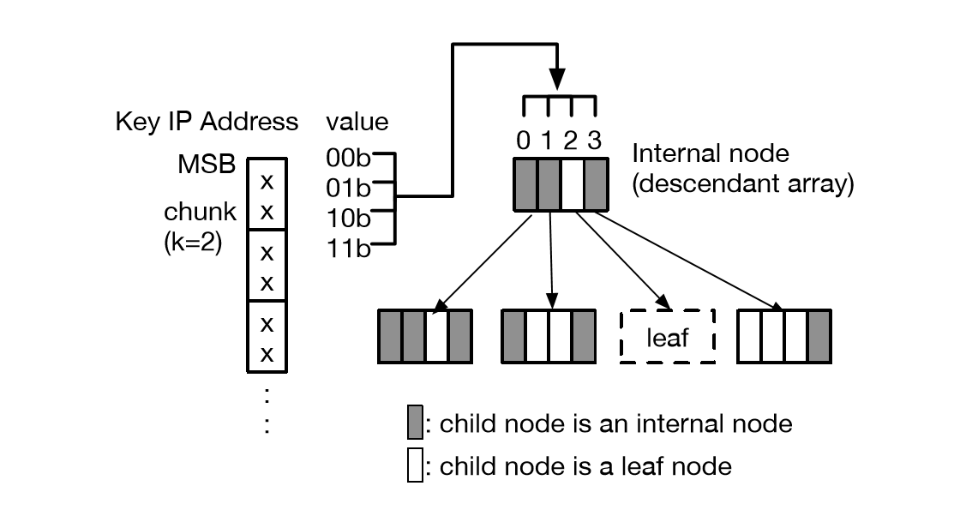

Poptrie
Poptrie is extended from the multiway trie (i.e., M-way or M-ary where M = $2^{k}$). Each node holds $2^{k}$ elements in the descendant array, corresponding to the value of the k-bit chunk in the key IP address.

Slide 5
Poptrie
The internal node in the basic poptrie contains
  vector (8 bytes)
  base0 (4 bytes)
  base1 (4 bytes)
  leafvec (8 bytes)
Each bit in the vector indicates the type of the child node
  1 if the corresponding child is an internal node
  0 if the corresponding child is a leaf node.

Slide 6
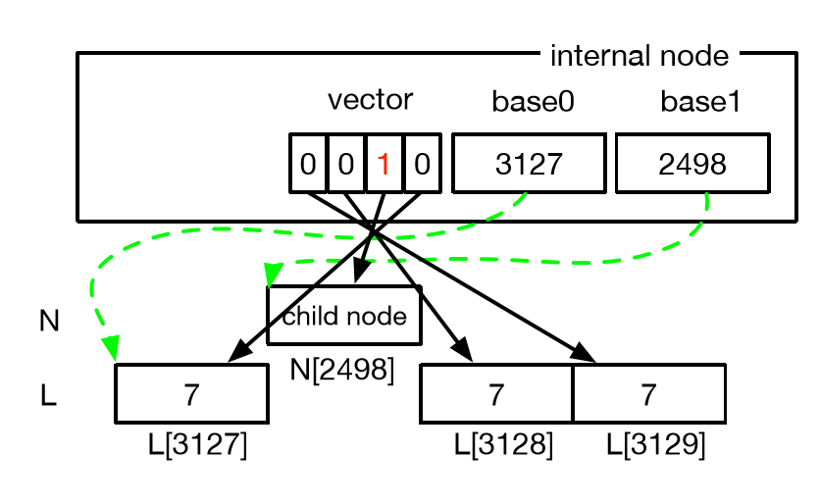

Poptrie
The vector and the base1 collectively serve as the descendant array. The vector is a bit-vector index of the length $2^{k}$ bits.

Slide 7
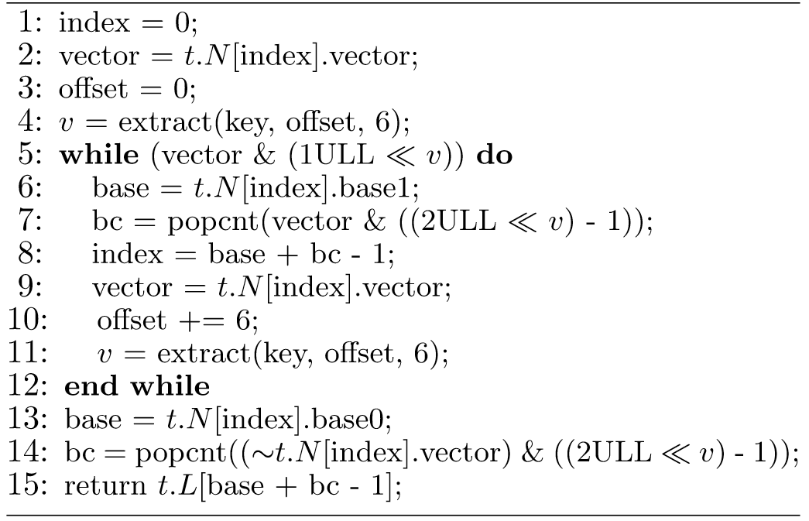
Lookup Algorithm

Slide 8
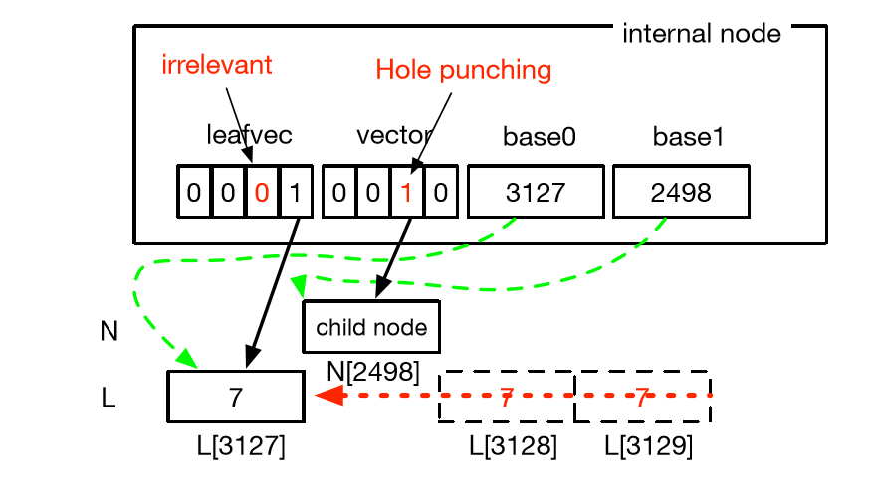

Compression with the Leaf Bit-Vector
The preﬁx expansion described in the previous subsection yields many duplicate and redundant leaves. In the ordinary $2^{k}$-ary multiway trie, an identical FIB entry corresponding to a shorter preﬁx may redundantly span to multiple leaves within an internal node, up to $2^{k}$−1 leaves.

Slide 9
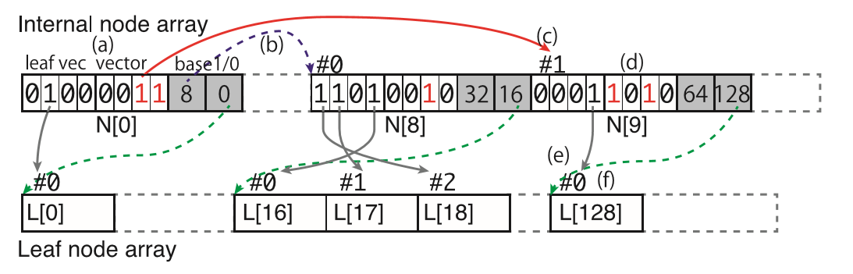
Lookup procedure
An example of the data structure of Poptrie where k = 2, and the lookup procedure for 0110b.

Slide 10
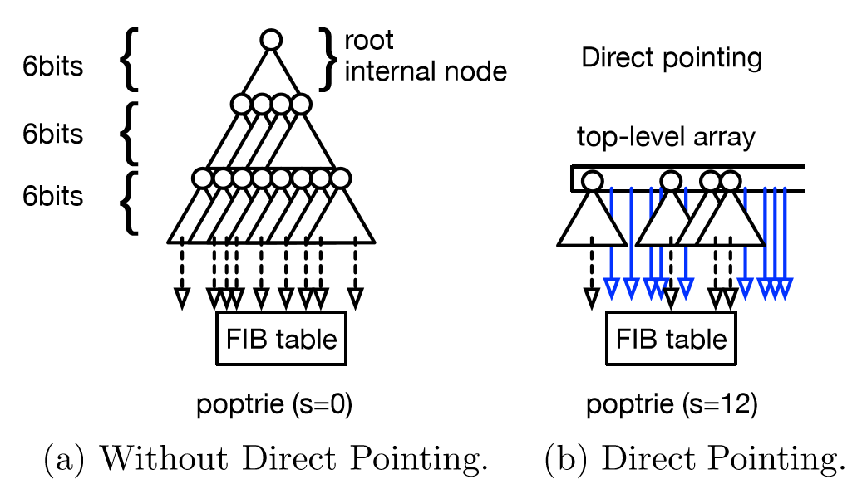
Direct Pointing
Most preﬁxes in the real datasets are distributed in the range of preﬁx length from /11 through /24. The lookup algorithm of any tree structure will always need to traverse at least some internal nodes to reach to a leaf node, incurring some expensive memory accesses.

Slide 11
Update
The incremental update of Poptrie is performed by replacing only the updated part of the trie.
We opt for a lock-free approach for the incremental update in Poptrie. The strategy here is to let the IP forwarding process keep referring to the current (i.e., older) FIB while the construction of the updated FIB is ongoing. When the update is ﬁnished, the current FIB is switched to the new one, by changing the pointer or the index of the FIB using an atomic instruction.

Slide 12
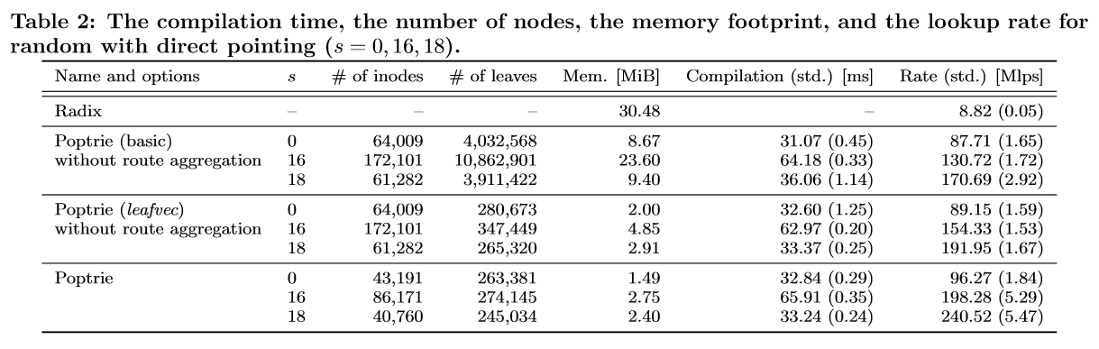
Evaluation

Slide 13
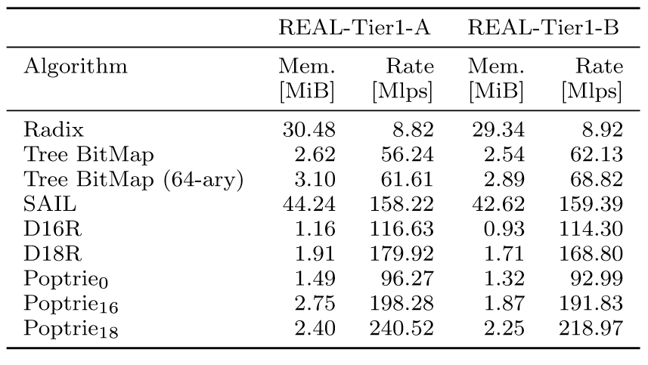
Evaluation

Slide 14
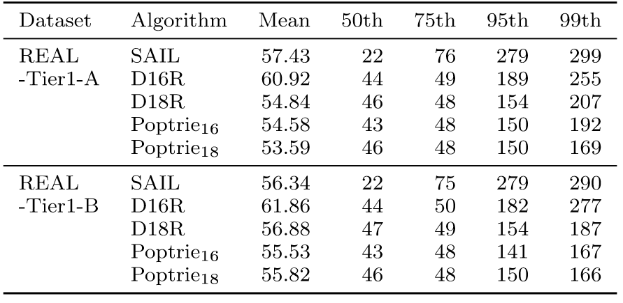
Evaluation

